Slide 1

Understanding and Evaluating BLUE: An Active Queue Management Algorithm
Shatabdi Dutta Chowdhury
Student ID - 2105123
Section - C
February 7, 2026

Slide 2

The Problem – Why This Research Matters?
Skyrocketing Internet Traffic :
Global data demands are outpacing hardware capabilities.
Buffer Limitations:
Routers have physical memory limits; they cannot hold "infinite" data.
The Triple Threat of Congestion:
Packet Loss : Data disappears, requiring retransmission.
High Latency/Delay : Significant lag in data delivery.
Jitter :
Inconsistent timing between packets, ruining real-time communication (like VoIP or Gaming).

Slide 3

The Critical Consequences
Resource Wastage: When a packet drops , resources to send that packet (bandwidth, power, time) are wasted.
The Downward Spiral: High packet loss rates lead to constant re-sending, which further chokes the network.
Congestion Collapse: This inefficiency can lead to a total network shutdown where no useful data gets through.

Slide 4

Understanding Network Congestion
What is Congestion ?
Definition:
A state in which the number of packets being transmitted through the network approaches or exceeds the packet-handling capacity of the network nodes (routers).
The Chain Reaction:
Queue Accumulation: Incoming data exceeds outgoing capacity, causing the router's buffer (queue) to fill up.
Increased Latency: Packets are forced to wait in the queue, causing significant delays.
Packet Dropping: Once the buffer is 100% full, the router has no choice but to discard incoming packets (Tail Drop).

Slide 5

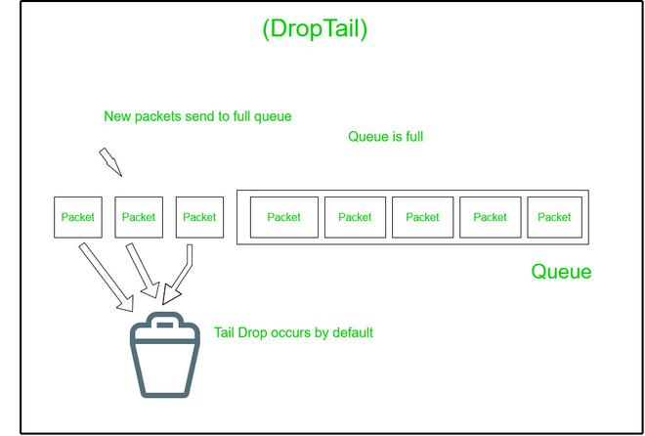
Traditional Solution – The DropTail Mechanism
How DropTail Works
Passive Management: Packets are accepted until the maximum buffer capacity is reached.
Full Buffer Drops: New incoming packets are only discarded
after the queue is 100% full.
Key Drawbacks:
Delayed Detection: It ignores congestion until the system is
already overwhelmed.
Sudden Packet Loss: Leads to "bursty" drops rather than smooth traffic management.
TCP Global Synchronization: Multiple senders reduce their speed at the exact same time, causing significant network under utilization.

Slide 6
RED (Random Early Detection) – Proactive Management
The Proactive Approach
Average Queue Length: Unlike DropTail, RED monitors the average queue size over time to detect early signs of congestion.
Probabilistic Dropping: It doesn't wait for a full buffer. It starts dropping packets randomly before the queue is full to signal senders to slow down.
Dual Thresholds:
Below min_th: No packets are dropped (Safe zone).
Between min_th & max_th: Packets are dropped with an increasing probability.
Above max_th: All packets are dropped (Congestion zone).
Goal: To maintain a small queue size and avoid "Global Synchronization."

Slide 7
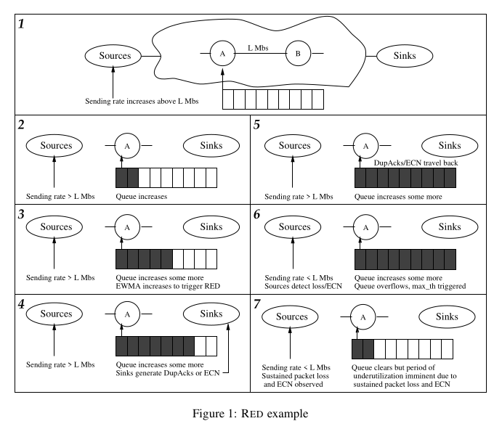

Red Scenerio

Slide 8
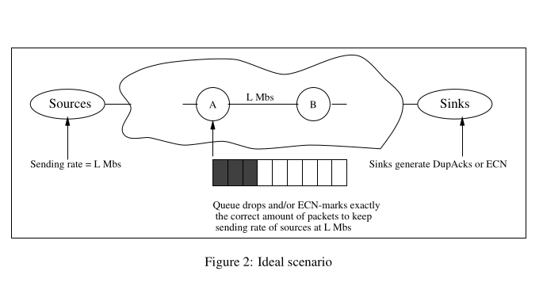
An Ideal Scenerio

Slide 9
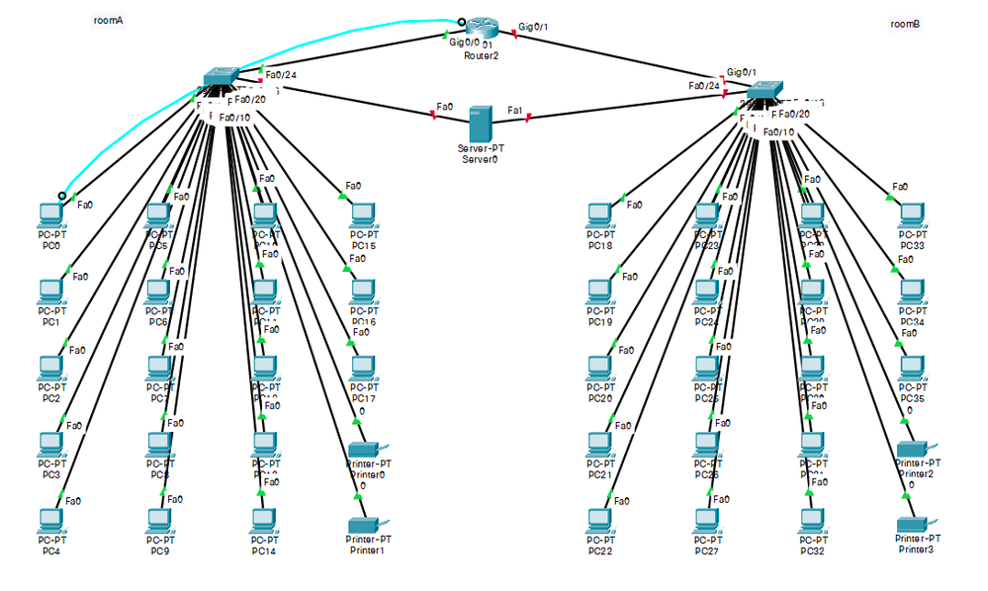
The Limitations of RED (Why It Fails)
Inaccurate Congestion Metric: Average queue length is not always a reliable indicator of true congestion.
Parameter Sensitivity: RED requires meticulous tuning of multiple parameters (minth​, maxth​, wq​). If not tuned perfectly, performance drops significantly.
Bursty Traffic Instability: Under high-speed or "bursty" traffic, RED becomes unstable, leading to either underutilization or excessive drops.
The Buffer Dilemma: To work effectively, RED often requires large buffers, which ironically introduces High Delay and Jitter (Bufferbloat).

Slide 10
The Key Idea Behind BLUE
A Paradigm Shift in AQM
Beyond Queue Length:
Experience-Based Feedback:
Event-Driven Observation:
Unlike RED, BLUE completely ignores queue length as a primary congestion metric.
The algorithm manages congestion based on actual events occurring at the router's interface.
Packet Loss (Congestion):
If the buffer overflows, BLUE realizes the drop probability is too low and increases it.
Link Idle Time (Underutilization):
If the link is idle while the queue is empty, BLUE realizes the drop probability is too high and decreases it.

Slide 11
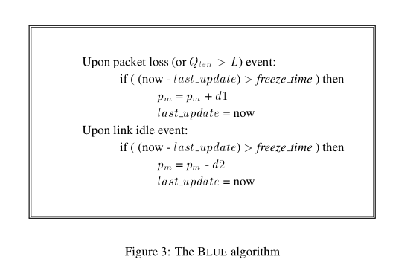
How BLUE Works (Algorithm)
Event 1: Packet Loss (or Queue Overflow)
If the router loses a packet or the queue exceeds a set limit (L):
Action: Increase pm​ by a small constant (d1).
Reason: The network is congested; we need to drop/mark more packets to slow down the senders.
Event 2: Link Idle
If the transmission link becomes idle (no data to send):
Action: Decrease pm​ by a small constant (d2).
Reason: The link is underutilized; we should drop/mark fewer packets to allow more traffic.
The "Freeze_Time" Variable:
To prevent the algorithm from reacting too fast or becoming unstable, it waits for a specific duration (freeze_time) before making the next adjustment.

Slide 12
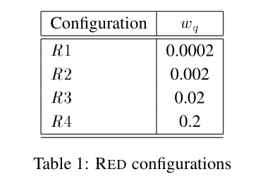
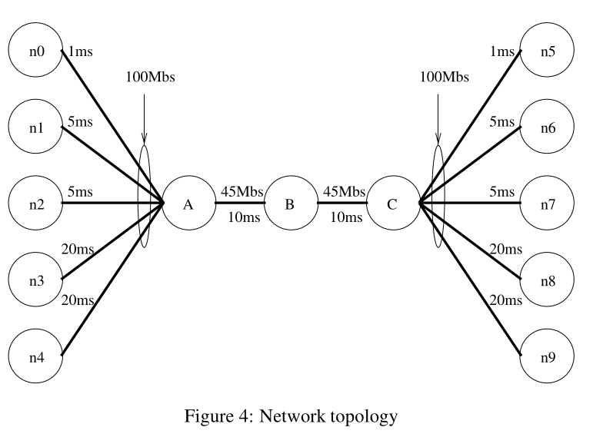
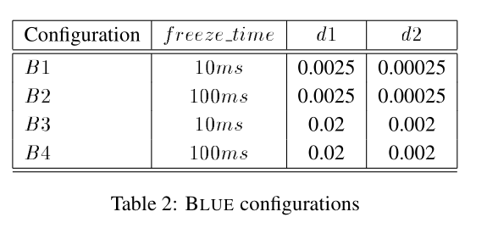
Experimental Setup

Slide 13
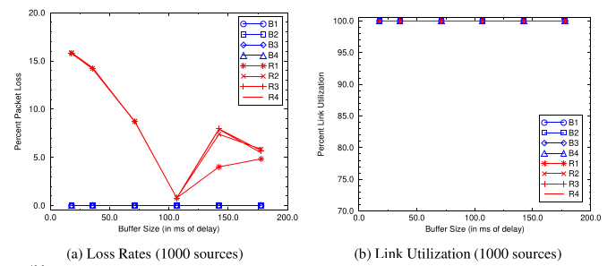
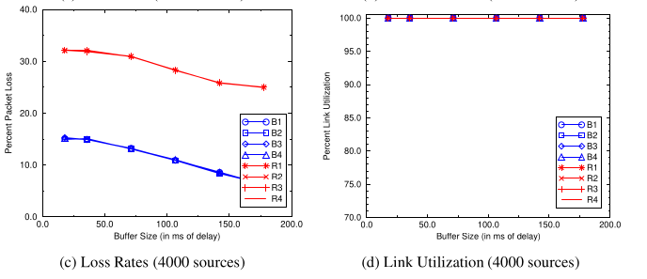
Experimental Results

Slide 14
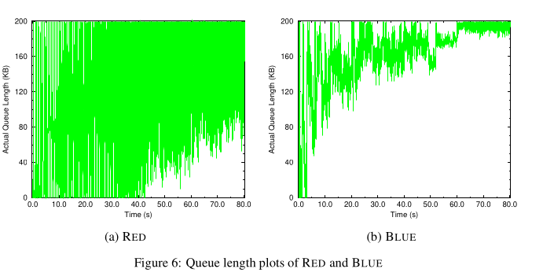
Queue Length

Slide 15
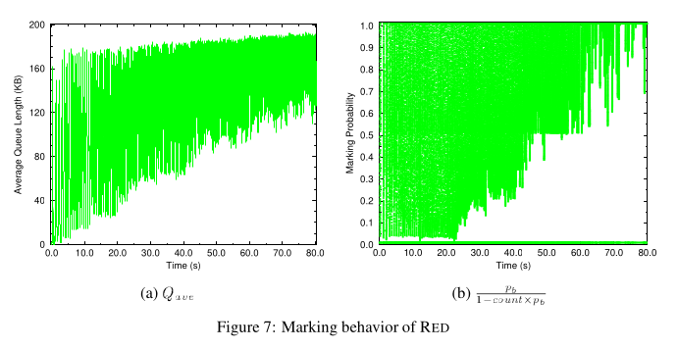
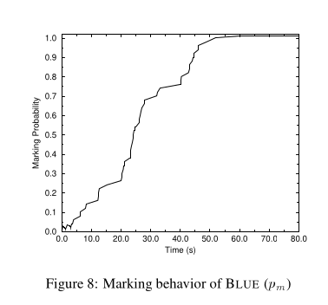
Marking Behaviour

Slide 16
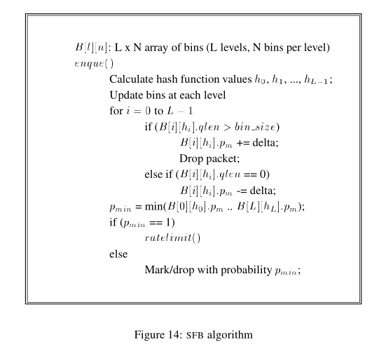
Stochastic Fair BLUE (SFB) - Fair Congestion Control
The Problem SFB Solves:
SFB Algorithm :
BLUE treats all flows equally
Non-responsive flows (UDP streaming, malicious traffic) can monopolize bandwidth
Responsive flows (TCP) suffer unfairly

Slide 17
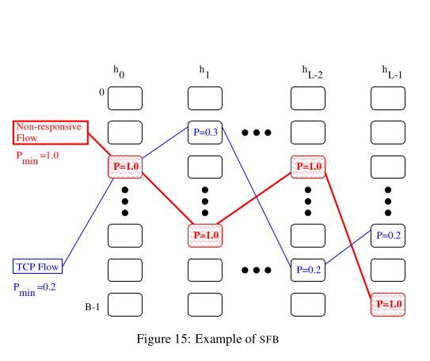
Stochastic Fair BLUE (SFB) - Fair Congestion Control
How It Works:
Each packet hashed to ONE bin per level (L bins total)
Each bin maintains its own pm value
Non-responsive flow → drives pm = 1 in ALL its bins
TCP flow → likely has at least ONE clean bin (pm < 1)
Final marking probability = minimum pm across all L bins

Slide 18
Research Gap - Why Modify BLUE?
1
BLUE works well for homogeneous TCP traffic
2
SFB provides fairness between flows
3
Modern networks have MIXED traffic (TCP + UDP + Real-time)
4
SFB has complexity: O(L×N) state, multiple hash functions
5
No adaptive mechanism for varying traffic conditions

Slide 19
Adaptive BLUE for Mixed Traffic
Core Idea
Detect traffic type
Adjust marking behavior
Maintain fairness
Three-Component Architecture:
Traffic Classifier
Adaptive Marking
Dynamic Learning

Slide 20
Traffic Classifier:
if (packet.protocol == TCP)
type = RESPONSIVE
else if (packet.protocol == UDP)
if (flow_rate > threshold)
type = NON_RESPONSIVE
else
type = REAL_TIME
Adaptive Marking
// TCP (Responsive)
pm_tcp = pm_base
// UDP Streaming (Non-responsive)
pm_udp = pm_base × α (where α > 1)
// Real-time (Gaming/VoIP)
pm_realtime = pm_base × β (where β < 1)
Dynamic Leraning
On packet loss:
if (non_responsive_detected) pm = pm + (d1 × γ)
else
pm = pm + d1
On link idle:
pm = pm - d2

Slide 21
My Implementation
BLUE
1
Stochastic Fair Blue
2
Adaptive Blue
3
4
Compare Between them using Metrics(Fairness Index, Latency, Throughput, Complexity)

Slide 22
Thank you

